Slide 1


GemFire Technical Background for Operators

Slide 2
GemFire Distributed Membership System

Slide 3



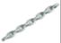
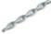
Cluster Startup
gemfire.properties
mcast-port= 0
locators=ServerA[40404],ServerB[40404]
40404
40404
ServerA
ServerB
Membership
UDP Unicast
UDP Unicast
UDP Unicast
UDP Unicast
Coordinator
Ack
Ack
Ack
Ack
Nack
Nack
Nack
TCP/IP
TCP/IP
Server
Server
Server
TCP/IP

Slide 4
Demo
Start a cluster
Observe the locator log, grep for "View" to isolate membership related messages.

Slide 5

Clients and Locators
Application
clientCache.xml
<client-cache>
<pool name=“client” min-connections=“2” max-connections=“3”>
<locator host=“ServerA” port=“40404” />
<locator host=“ServerB” port=“40404” />
</pool>
</client-cache>
Pool
40404
40404
ServerA
ServerB
Server
Server
Server

Slide 6
Replicated Regions
Products
Products
Products

Slide 7
Partitioned Regions
Customers
Customers
Customers
Customers
Products
Products
Products

Slide 8

Partition Buckets
serverCache.xml
<cache>
<region name=“Customers” data-policy=“partition” redundancy=“1” total-num-buckets=“113”>
<region-attributes>
<partition-attributes>
<partition-resolver=“CustomerPartitionResolver”>
<class-name>myPackage.CustomerPartitionResolver </class-name>
</partition-resolver>
</partition-attributes>
<region-attributes>
<region>
</cache>
put(key,value)
or
put(key, value, contextObject)
Partition Resolver
Serializable getRoutingObject(EntryOperation<K,V> op)
If no
Partition
Resolver
Alternatively, ….
the Key class or the Context Object class may implement the PartitionResolver interface
“the Routing Object”
hashCode()
(hashCode % total-num-buckets) +1
1
2
3
4
5
6
7
…
bucketId
(where 0 < bucketId <= total-num-buckets)

Slide 9
Partition Redundancy
// gfsh
create region --name=Customers --type=PARTITION_REDUNDANT --redundant-copies=1
Customers_{R}
Customers
Customers
Customers_{R}
Customers_{R}
Customers
Products
Products
Products

Slide 10


Partition Redundancy Detail
Application
put(key,value)
1
6
Customers
Customers
Customers
3
1
3
6
5
4
2
4
2
5
Customers_{R}
Customers_{R}
Customers_{R}
Products
Products
Products

Slide 11
Bucket Promotion
1
6
Customers
Customers
5
3
1
2
3
6
2
Customers
4
4
5
Customers_{R}
Customers_{R}
Customers_{R}
Products
Products
Products

Slide 12
Redundancy Recovery
//gfsh
create region --name=Customers --type=PARTITION_REDUNDANT --redundant-copies=2 --recovery-delay=10000
Customers
Customers
1
6
6
3
5
3
5
2
4
1
2
4
Customers_{R}
Customers_{R}
Customers_{R}
Products
Products

Slide 13
Basic Cache Operations
// Insert or update a customer record into the cache
customerRegion .put(customerIdX, customerObjX);
// Alternatively, insert or update a customer record into the cache with a context
customerRegion .put(customerIdX, customerObjX, context);
Application
put(key,value)
get(key)
// Retrieve a customer record from the cache
Customer customerY = customerRegion .get(customerIdY);
// Retrieve a customer record from the cache with a context
Customer customerY = customerRegion .get(customerIdY, context);
Region
Cache
Regions also implement Map<K,V>, ConcurrentMap<K,V>

Slide 14
Colocated Regions
// gfsh
create region --name=Orders --type=PARTITION_REDUNDANT --redundant-copies=1 --colocated-with=Customers
1
6
3
4
5
Customers
Customers
4
1
2
5
Customers
2
6
3
Customers_{R}
Customers_{R}
Customers_{R}
Orders
Orders
Orders
1
6
4
2
3
1
2
5
4
5
6
3
Orders_{R}
Orders_{R}
Orders_{R}
Products
Products
Products

Slide 15
Rebalancing
//gfsh
create region --name=Customers --type=PARTITION_REDUNDANT --redundant-copies=1 ---recovery-delay=10000 --startup-recover-delay=10000
Customers
Customers
Customers
Customers
Customers
Customers
1
6
5
4
3
2
3
1
2
4
6
5
Customers_{R}
Customers_{R}
Customers_{R}
Customers_{R}
Customers_{R}
Customers_{R}
Customers_{R}
Products
Products
Products
Products

Slide 16
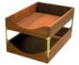

Single-Hop Optimization
Application
clientCache.xml
<client-cache>
<pool name=“client” min-connections=“3” max-connections=“9” pr-single-hop-enabled=“true”>
<locator host=“ServerA” port=“40404” />
</pool>
<region name=“Customers” pool-name=“client”>
<region-attributes refid=“CACHING_PROXY”>
<partition-attributes>
<partition-resolver=“CustomerPartitionResolver”>
<class-name>myPackage.CustomerPartitionResolver </class-name>
</partition-resolver>
</partition-attributes>
</region-attributes>
</region>
</client-cache>
get(key) - Bucket 6
Customers
Customers
Customers
Customers
Customers
Customers
4
5
1
6
4
2
3
1
2
5
6
3
Customers_{R}
Customers_{R}
Customers_{R}
Customers_{R}
Customers_{R}
Customers_{R}
Products
Products
Products
Products
Products
Products

Slide 17
Parallel, Shared Nothing Persistence
Customers
Customers
Customers
1
6
4
2
3
1
2
5
4
5
6
3
Customers_{R}
Customers_{R}
Customers_{R}
Products
Products
Products

Slide 18
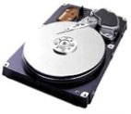

Parallel, Shared Nothing Persistence
Locator
(Membership Coordinator)
Customers
Customers
Customers
1
6
4
2
3
1
2
5
4
5
6
3
Customers_{R}
Customers_{R}
Customers_{R}
Products
Products
Products
1
,5
3
1
,6
,2
,3
,4
,6
,4
,2
,5

Slide 19
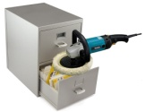
Parallel, Shared Nothing Persistence
Locator
(Membership Coordinator)
Customers
Customers
Customers
1
6
4
2
3
1
2
5
4
5
6
3
Customers_{R}
Customers_{R}
Customers_{R}
Products
Products
Products
OS File Buffer
1
,5
3
1
,6
,2
,3
,4
,6
,4
,2
,5

Slide 20
Shutdown
> gemfire shut-down-all
Locator
(Membership Coordinator)
Customers
Customers
Customers
1
6
4
2
3
1
2
5
4
5
6
3
Customers_{R}
Customers_{R}
Customers_{R}
Products
Products
Products
1
,5
3
1
,6
,2
,3
,4
,6
,4
,2
,5

Slide 21
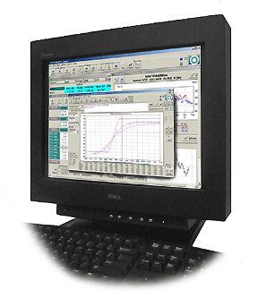

Parallel Recovery
> gfsh start locator ...
> gfsh start server ... (x3)
Locator
(Membership Coordinator)
Customers
Customers
Customers
1
6
4
2
3
1
2
5
4
5
6
3
Customers_{R}
Customers_{R}
Customers_{R}
Products
Products
Products
1
,5
3
1
,6
,2
,3
,4
,6
,4
,2
,5

Slide 22
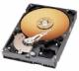
Disk Stores
//gfsh
create disk-store --name=persistentStore --dir=/data1/customers#1000 --dir=/data2/customers
--dir=/data3/customers --auto-compact=true --allow-force-compactin=true --max-oplog-size=100
Application
/data1/customers
put(key,value)
-rw-rw-r-- 1 gemfire users 1924 Mar 22 13:57 BACKUPpersistentStore.if
-rw-rw-r-- 1 gemfire users 0 Mar 22 13:56 DRLK_IFpersistentStore.lk
-rw-rw-r-- 1 gemfire users 943718 Mar 22 13:57 BACKUPpersistentStore_1.crf
Disk Store and Region(s) Metadata
Region
-rw-rw-r-- 1 gemfire users 104857 Mar 22 13:57 BACKUPpersistentStore_1.drf
Region
Runtime Lock File
/data2/customers
Create, Update, Invalidate Operations
90% - pre-allocated - 10%
Delete Operations
Cache
max-oplog-size
Cache
/data3/customers

Slide 23
Disk Stores - Rollover
//gfsh create disk-store --name=persistentStore --dir=/data1/customers#1000 --dir=/data2/customers
--dir=/data3/customers --auto-compact=true --allow-force-compactin=true --max-oplog-size=100
Application
/data1/customers
put(key,value)
-rw-rw-r-- 1 gemfire users 1924 Mar 22 13:57 BACKUPpersistentStore.if
-rw-rw-r-- 1 gemfire users 0 Mar 22 13:56 DRLK_IFpersistentStore.lk
-rw-rw-r-- 1 gemfire users 939083 Mar 22 13:57 BACKUPpersistentStore_1.crf
Region
-rw-rw-r-- 1 gemfire users 48952 Mar 22 13:57 BACKUPpersistentStore_1.drf
Region
/data2/customers
-rw-rw-r-- 1 gemfire users 943718 Mar 22 13:57 BACKUPpersistentStore_2.crf
Cache
-rw-rw-r-- 1 gemfire users 104857 Mar 22 13:57 BACKUPpersistentStore_2.drf
Cache
/data3/customers
Files are closed with true size
File Number Increments
When oplogs reach max-oplog-size
New Files are pre-allocated

Slide 24


Disk Stores - Compaction
//gfsh
create disk-store --name=persistentStore --dir=/data1/customers#1000 --dir=/data2/customers
--dir=/data3/customers --auto-compact=true --allow-force-compactin=true --max-oplog-size=100
Application
/data1/customers
put(key,value)
-rw-rw-r-- 1 gemfire users 1924 Mar 22 13:57 BACKUPpersistentStore.if
-rw-rw-r-- 1 gemfire users 0 Mar 22 13:56 DRLK_IFpersistentStore.lk
-rw-rw-r-- 1 gemfire users 939083 Mar 22 13:57 BACKUPpersistentStore_1.crf
Region
-rw-rw-r-- 1 gemfire users 48952 Mar 22 13:57 BACKUPpersistentStore_1.drf
Region
/data2/customers
-rw-rw-r-- 1 gemfire users 912428 Mar 22 13:57 BACKUPpersistentStore_2.crf
Cache
-rw-rw-r-- 1 gemfire users 104687 Mar 22 13:57 BACKUPpersistentStore_2.drf
Cache
When auto-compact is true or by invoking
/data3/customers
compact disk-store --name=persistentStore
-rw-rw-r-- 1 gemfire users 943718 Mar 22 13:57 BACKUPpersistentStore_3.crf
-rw-rw-r-- 1 gemfire users 104857 Mar 22 13:57 BACKUPpersistentStore_3.drf

Slide 25
GemFire and the File System
Product Directory
Can be anywhere
Can be read only
Working Directory
Must be writable by “run as” user
Required by both locators and servers
Set with the “--dir” option of the “gfsh start server/locator” command
Logs and Stats
gemfire automatically rolls logs and stats
use properties to set location and size limits
log/stats location must be writable, should be local
Disk Stores (where the data lives)
Must be writeable by “run as” user

Slide 26
GemFire and the File System
Sample Log Configuration
log-level=config
statistic-sampling-enabled=true
statistic-archive-file=server.gfs
archive-file-size-limit=10
archive-disk-space-limit=100
log-file=server.log
log-file-size-limit=10
log-disk-space-limit=100

Slide 27
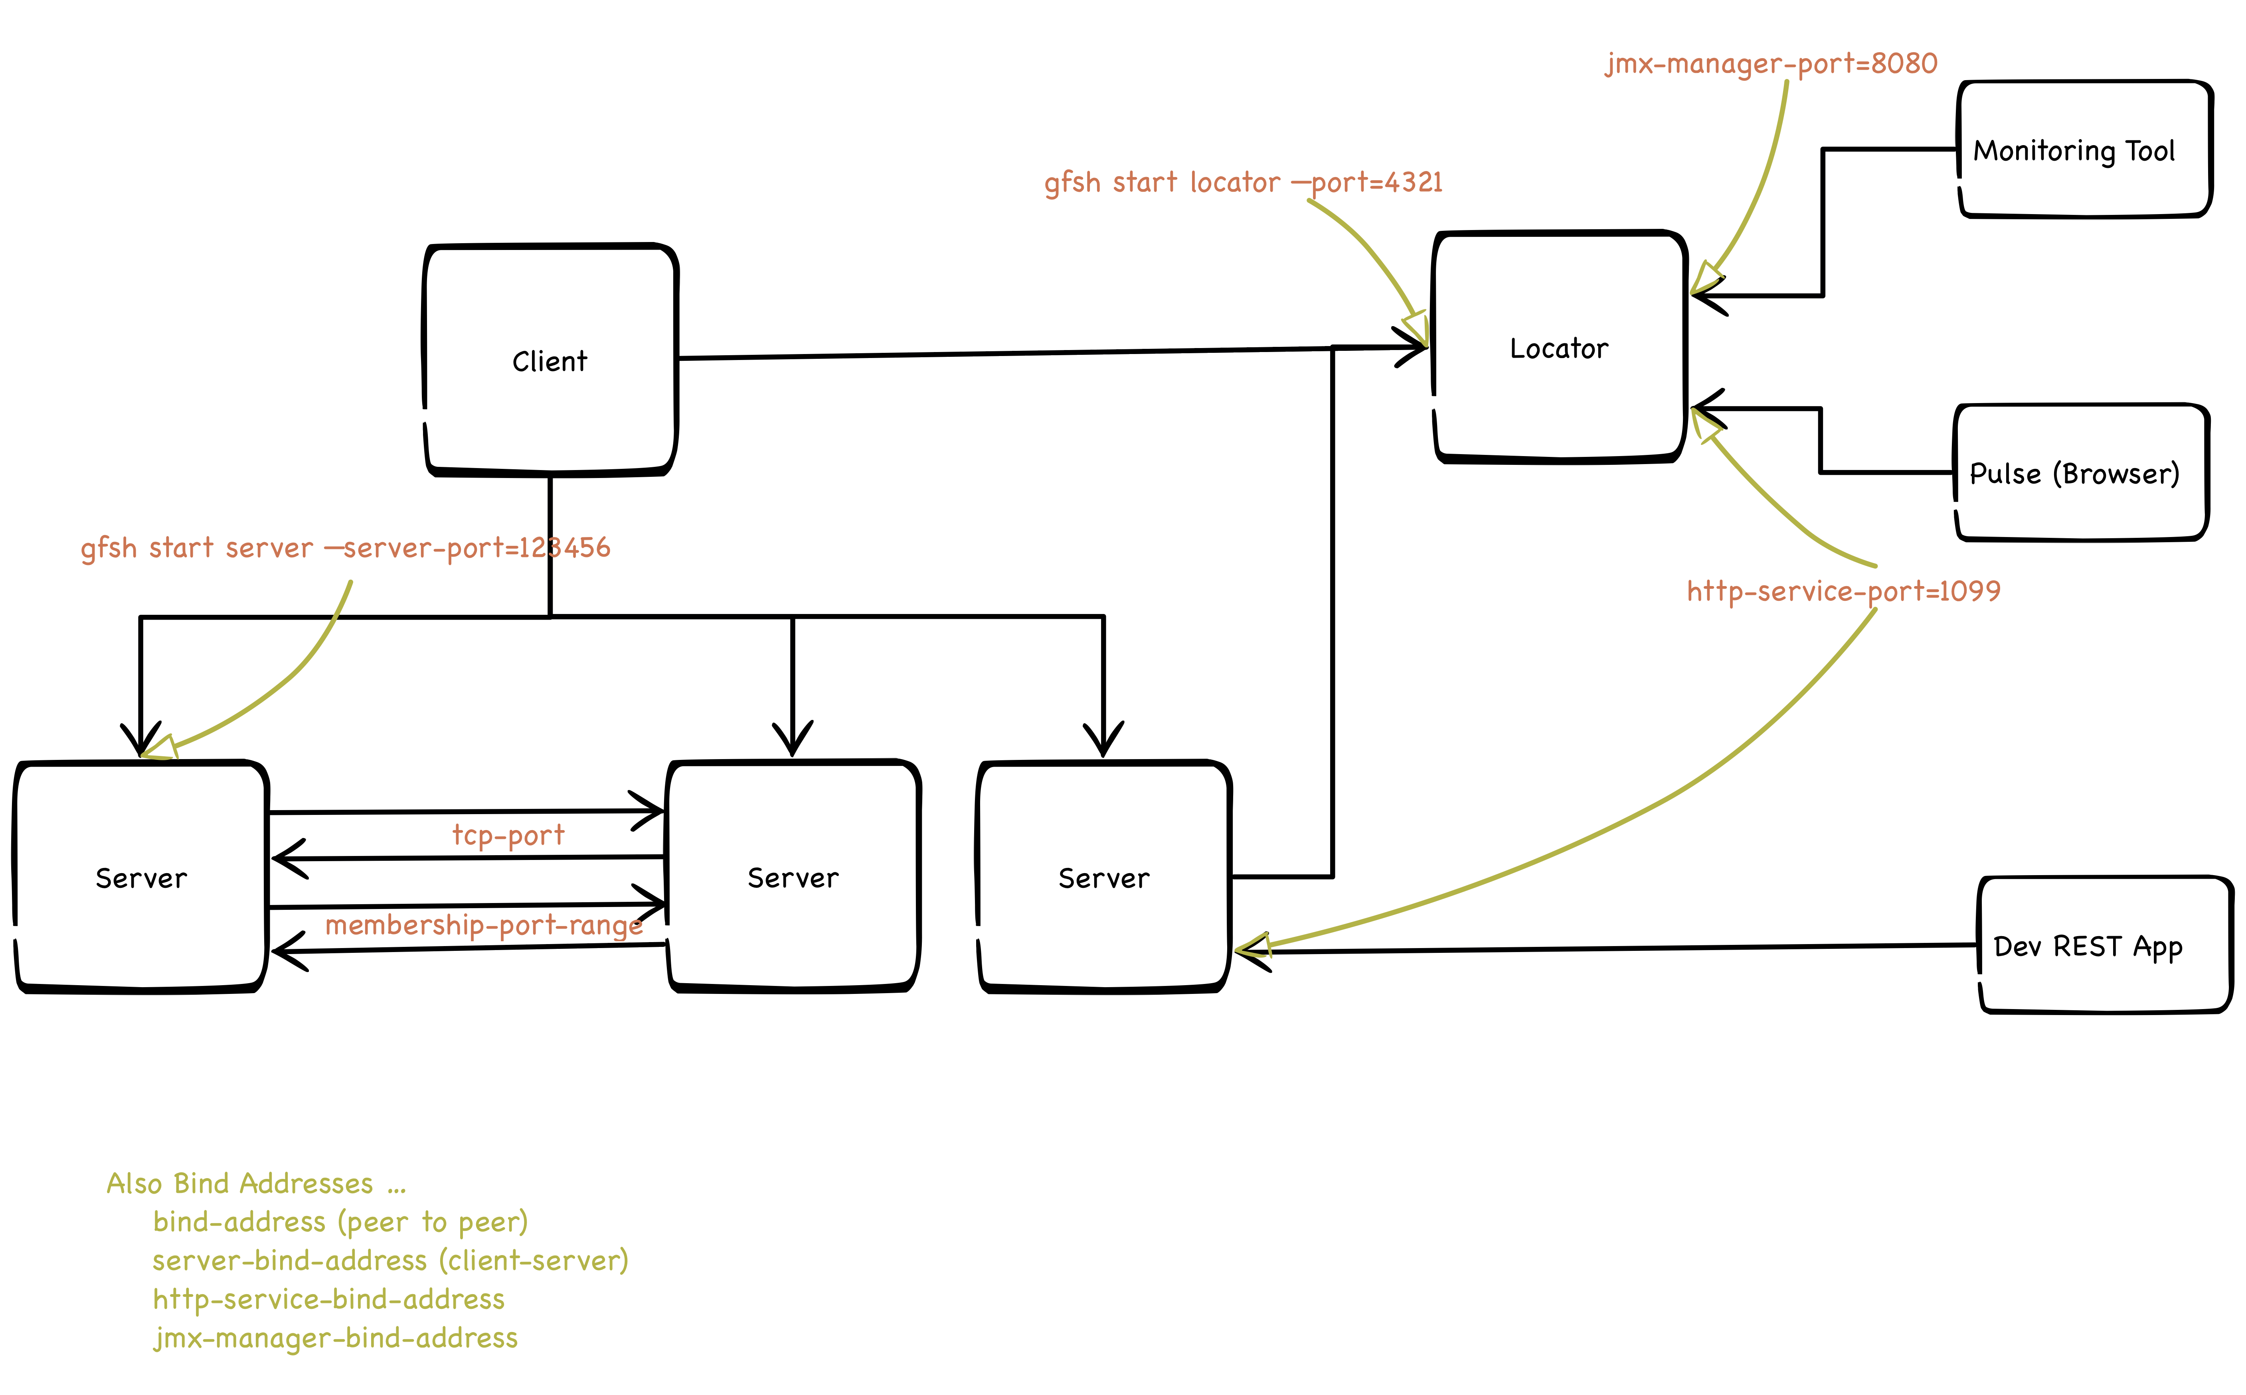
GemFire and the Network

Slide 28
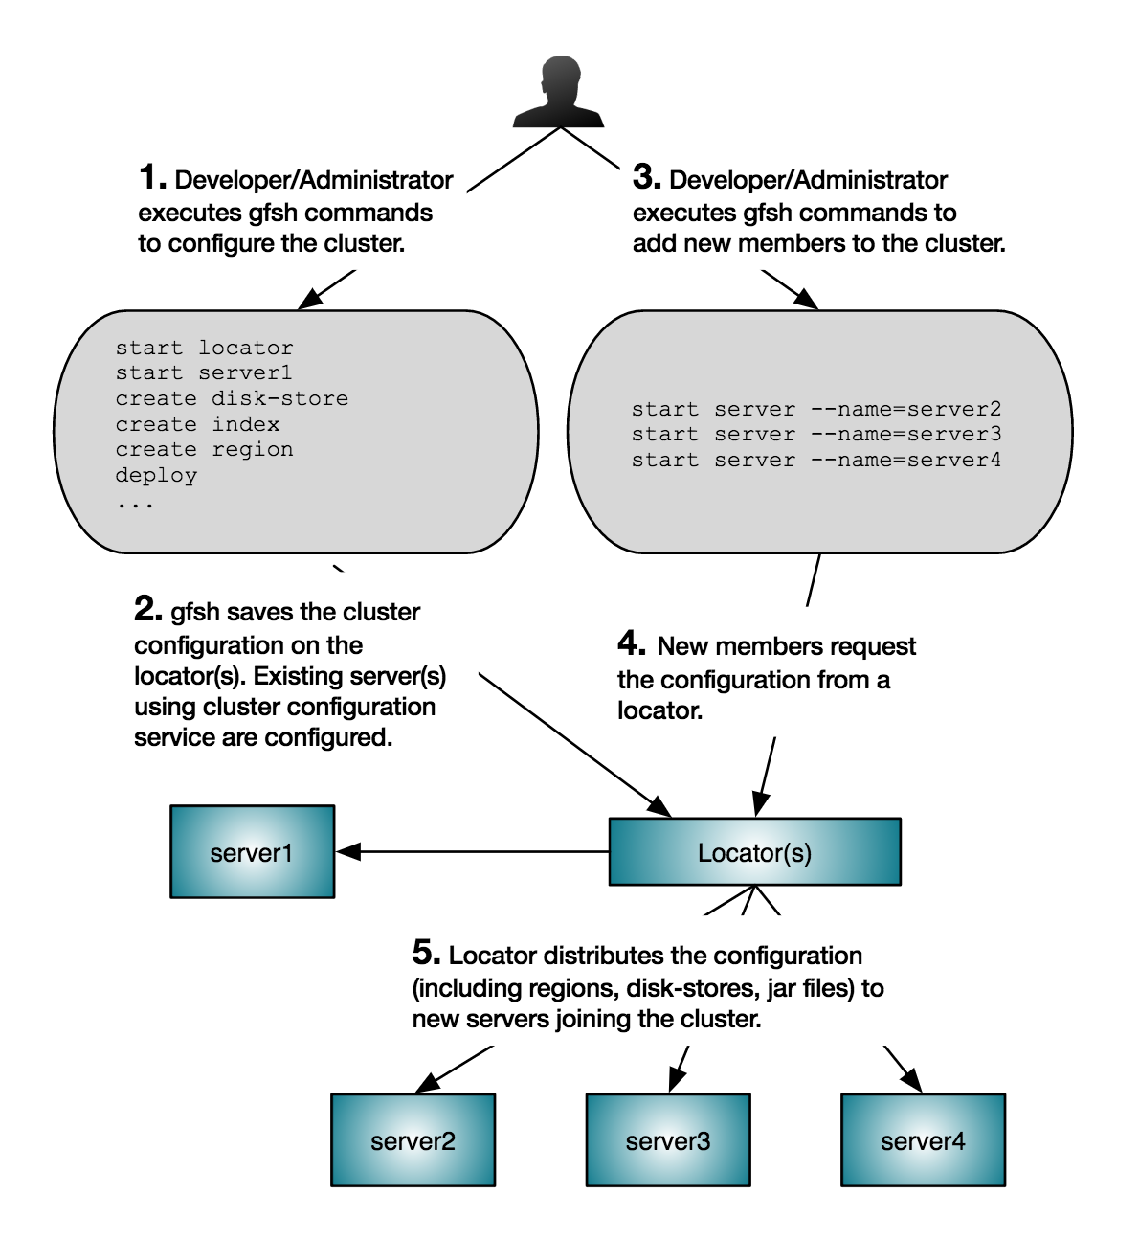
The Cluster Configuration Service - How It Works

Slide 29
The Cluster Configuration Service
Caveats and Best Practices
Do Not Use With cache.xml - This will appear to work but can lead to problems that prevent nodes from coming up after restart.
Data is stored in the locator working directory - do not delete it !
PDX configuration does not apply to running members. This leads to a chicken and egg problem with new clusters that will use pdx. To overcome this, when a new cluster is first created, follow this procedure.
start the cluster
create the pdx disk store: gfsh> create disk-store --name=pdx-disk-store --dir=/data/pdx
configure pdx: configure pdx --disk-store=pdx-disk-store --read-serialized=true
stop all the data nodes (locators can stay up): gfsh> shutdown
start the cluster

Slide 30
Lab Prerequisites
We will use the T-Mobile scripts. Please be sure you are comfortable with the following.
You know the names or IP addresses of all the servers in your cluster and you have ssh access to each one
You can start and stop the individual data nodes and locators
You can connect to the cluster. Test this by connecting and running list members
Your cluster had been configured with pdx-read-seralized=true. To check this, connect to your cluster and run describe config --member=member-name . If you do not see any reference to pdx-read-serialized then it has not been set and you need to set it.
The cluster is brand-new. No data has been written to the cluster. This is important! If need be, re-install the cluster.
Pick one machine to be your admin box (e.g. locator1) and copy all of the lab materials onto that machine. Many of the instructions will assume you are on the admin box in the tmobile-ops-workshop directory.

Slide 31
Cluster Start Instructions
create a working directory in gemfire user home (e.g. mkdir locator1)
put gemfire.properties from the email in the working directory
for locators:
gfs start locator --dir=locator --name=locator1/2 --port=10334 --locators=locator1-ip-or-name[10334],locator2-ip-or-name[10334]
for data nodes:
gfsh start server --dir=server --name=server1/2/3 --locators=locator1-ip-or-name[10334],locator2-ip-or-name[10334]

Slide 32
Lab 0: Set Up, Using gfsh
We will start by creating a persistent region and loading some data. The instructions assume you are on the admin box and the current directory is tmobile-ops-workshop.
Start all cluster members
2. Edit create_regions.gfsh . Review the file and optionally set the disk store directory to the desired location.
3. Run gfsh in batch mode:
gfsh -e “connect --locator=hostname[port] --user=fred --password=pass” -e “run --file=create_regions.gfsh”
4. Now, run the loader program to load some people.
python peopleloader.py --locator=hostname[port] --username=auser --password=pass
--region=Person --count=100000 --threads=10

Slide 33
Lab 0: Set Up, Using gfsh - continued
Now connect using gfsh and perform some inspection.
gfsh>connect --locator=localhost[10000] --user=admin --password=adm1n
Connecting to Locator at [host=localhost, port=10000] ..
Connecting to Manager at [host=192.168.1.123, port=10099] ..
Successfully connected to: [host=192.168.1.123, port=10099]
Cluster-1 gfsh>list members
Name | Id
--------- | -------------------------------------------------
locator2 | 192.168.1.123(locator2:3881:locator)<ec><v0>:1024
locator1 | 192.168.1.123(locator1:3905:locator)<ec><v1>:1025
datanode3 | 192.168.1.123(datanode3:3948)<v2>:10901
datanode1 | 192.168.1.123(datanode1:3949)<v2>:10902
datanode2 | 192.168.1.123(datanode2:3950)<v2>:10903

Slide 34
Lab 0: Set Up, Using gfsh - continued
Cluster-1 gfsh>describe region --name=Person
..........................................................
Name : Person
Data Policy : persistent partition
Hosting Members : datanode1
datanode2
datanode3
Non-Default Attributes Shared By Hosting Members
Type | Name | Value
--------- | ---------------------- | --------------------
Region | data-policy | PERSISTENT_PARTITION
| disk-store-name | person-disk-store
| size | 100000 <<< Entry Count (not incl. copies)
Partition | redundant-copies | 2 <<< total copies = 3
| startup-recovery-delay | 300000
| recovery-delay | 300000

Slide 35
Lab 0: Set Up, Using gfsh - continued
Cluster-1 gfsh>show metrics --region=Person
Cluster-wide Region Metrics
Category | Metric | Value
--------- | ---------------------------- | ------
....
| bucketCount | 226 << 2 x 113
| primaryBucketCount | 113
| numBucketsWithoutRedundancy | 0 << All data for region if fully redundant
| totalBucketSize | 200000 << Total entries incl. copies
| averageBucketSize | 294
diskstore | totalEntriesOnlyOnDisk | 0 << No overflow
...

Slide 36
Lab 0: Set Up, Using gfsh - continued
Other useful gfsh commands you can try out:
list regions
describe member --name=datanode1
show metrics --member=datanode1
show log --member=datanode1
query --query="select * from /Person where address.state = 'TX'”
When you are done experimenting, stop the cluster for the next lab
shutdown --include-locators=true
Best Practice
When shutting down the whole cluster, use the shutdown command. Do not stop one member at a time. Do not use kill. This can lead to data loss.

Slide 37
Lab 1: Proper Startup Procedure w\ Disk Stores
Start one locator then without waiting for the first one to finish coming up, start the second locator.
There is a known issue with GemFire 9.1.0 that can cause the locators to each form their own cluster if they are started in close succession. It is not a problem when performing a manual start but can be a problem for automated startups. The workaround is to wait at least 5 seconds after launching the first locator to launch the second. The issue is fixed in GemFire 9.1.1
First we are going to use an improper startup procedure to demonstrate a very important behavior of disk stores.
Start one data node. There is a very good chance this will hang. Connect to your cluster with gfsh and run the following command:
show missing-disk-stores
This is expected. We will discuss why this happens.

Slide 38
Lab 1: Proper Startup Procedure w\ Disk Stores
Resolve the issue by starting the other 2 data nodes.
Best Practices
Start your data nodes in parallel. Revoking disk stores during startup is rarely the right thing to do.
Once all of your data nodes are started, use gfsh to show that there are no missing disk stores.

Slide 39
Lab 1: Proper Startup Procedure w\ Disk Stores
During locator startup, you may see a message like the following.
Cluster configuration service is waiting for other locators with newer shared configuration data.
This locator might have stale cluster configuration data.
Following locators contain potentially newer cluster configuration data
Host : /192.168.1.123
Directory : /Users/rmay/GoogleDrive/projects/tmobile-ops-workshop/localenv/locator2/ConfigDiskDir_locator2
Best Practice
As of GemFire 9.x, the locators also require parallel startup because the cluster configuration is contained in disk stores in the locator working directory.

Slide 40
Lab 2: Rolling Bounce
Settings that are applied on the java command line or that come out of “gemfire.properties” or “gfsecurity.properties” cannot be modified at runtime but many can be applied with a rolling bounce which requires no down time.
However, it is important to follow certain procedures to avoid data loss.
In this lab we will explore redundancy recovery and how it relates to the rolling bounce.
All partitioned regions have 2 settings:
--recovery-delay:
controls how long the cluster waits after a failure before replacing the lost copies
--startup-recovery-delay:
controls how long after starting a new member to replace missing replicas (if any)
Its important to realize that you may have regions with differing recovery properties in one cluster. We will discuss some of the tradeoffs in class.

Slide 41
Lab 2: Rolling Bounce
stop data node #3
run the gfsh show metrics command:
Cluster-1 gfsh>show metrics --region=Person
Cluster-wide Region Metrics
Category | Metric | Value
--------- | ---------------------------- | ------
cluster | member count | 2
| region entry count | 100000 << still have the correct number of entries
--- SNIP ---
| bucketCount | 152
| primaryBucketCount | 113
| numBucketsWithoutRedundancy | 74 << caution!
If you stop anything else you could lose data.

Slide 42
Lab 2: Rolling Bounce
show missing-disk-stores
also note there are missing disk stores - this is expected
start datanode3 again.
Your next step is so stop data node 2 but before you do, make sure redundancy is fully recovered using show metrics.
Best Practice
Before stopping any data node, make sure redundancy is not compromised.
Repeat the process for datanode2 and datanode3.
When you are done, issue a rebalance to spread out the primaries.
rebalance

Slide 43
Lab 2: Rolling Bounce
Although checking redundancy for the one or two largest regions is probably ok, it is best to check all regions. In the lab materials, a useful utility has been included to do just this.
python gemtools/checkred.py --jmx-manager-host=hostname--jmx-manager-port=10099 --jmx-username=admin --jmx-password=adm1n --verbose
GemFire:service=Region,name=/Person,type=Distributed /Person : 0 buckets without redundancy
all partitioned regions have redundancy
The source for this is included with the lab materials and also included here:
https://github.com/Pivotal-Data-Engineering/gemfire-toolkit

Slide 44
Lab 3: Shrink
Now we will “permanently” shrink the cluster from 3 to 2 data nodes.
Stop data node 3
Connect with gfsh and check redundancy. Also observe that there are missing disk stores.
show missing disk stores
...
show metrics --region=Person
...
python ../gemtools/checkred.py --jmx-manager-host=localhost --jmx-manager-port=10099 --jmx-username=admin --jmx-password=adm1n --verbose
GemFire:service=Region,name=/Person,type=Distributed /Person : 75 buckets without redundancy
Issue a rebalance to recover redundancy.
rebalance

Slide 45
Lab 3: Shrink
Since we are permanently shrinking the cluster, we will not be needing those missing disk stores we can go ahead and revoke them.
show missing-disk-stores
Missing Disk Stores
Disk Store ID | Host | Directory
------------------------------------ | -------------- |-----------------------
c72d3d72-825d-4475-910e-326794e1b892 | /192.168.1.123 | SNIP
c72d3d72-825d-4475-910e-326794e1b892 | /192.168.1.123 | SNIP
SNIP
Cluster-1 gfsh>revoke missing-disk-store --id=c72d3d72-825d-4475-910e-326794e1b892
Missing disk store successfully revoked

Slide 46
Lab 3: Shrink
We now have a healthy 2 node cluster. We can repeat the process to shrink further.
Note: if you shrink to less than redundant-copies + 1 nodes, you will not be able to maintain full redundancy.
Extra Credit: try to start datanode 3. You will see an exception like the following:
Exception in thread "main" org.apache.geode.cache.persistence.RevokedPersistentDataException: The persistent member id c72d3d72-825d-4475-910e-326794e1b892 has been revoked in this distributed system. You cannot recover from disk files which have been revoked.
If you try to start a data node that “owns” revoked disk stores, it will fail.
Clear out the disk store directory for data node 3 so we can continue.

Slide 47
Lab 4: Grow
We now have a healthy 2 node cluster. Now we will grow to 3 nodes. Be sure you have cleaned out the disk stores for data node 3 before starting.
start data node 3
Note that the data does not automatically “spread out”:
Cluster-1 gfsh>show metrics --member=datanode3 --categories=region
Member Metrics
Category | Metric | Value
-------- | ---------------------------- | -------
region | totalRegionCount | 1
SNIP
| totalRegionEntryCount | 2 << its basically empty

Slide 48
Lab 4: Grow
If you were adding more than one member, you would start the other members now.
Once you have started all the members, perform a rebalance to spread out the data.
rebalance
Once more, verify you are at full redundancy and there are no missing disk stores.
python ../gemtools/checkred.py --jmx-manager-host=localhost --jmx-manager-port=10099 --jmx-username=admin --jmx-password=adm1n --verbose
GemFire:service=Region,name=/Person,type=Distributed /Person : 0 buckets without redundancy
all partitioned regions have redundancy
show missing-disks-stores
Congratulations. You now have a healthy 3 node cluster.

Slide 49
Recap of Best Practices for Starting and Stopping
start cache servers concurrently, not sequentially
do not stop a cache server if any buckets lack redundancy
restart as rolling bounce, wait for redundancy as needed
use “gfsh shutdown” to stop the whole cluster (not one by one)
redundancy may not be restored after a failure (depends on settings)
data will not automatically spread to new machines (use rebalance)

Slide 50
The Need for Automation
Managing a GemFire cluster of any size by hand is very difficult and error prone.
gfsh cannot start remote processes
there can be small configuration differences between each server (e.g. bind addresses).
Not adhering to procedures carefully can lose data.
Automation is Essential!

Slide 51
Backup and Export
Backup / Restore
True system backup
Backs up all regions, configurations and jars
Supports incremental backups
Data is written from all nodes in parallel
Is a disk store based operation. Only works for persistent regions
Must be restored into a cluster with the same number of data nodes
Cluster must be stopped during restore
Export/Import
Not a full system backup, great tool for moving data between environments
Can export individual regions
All data sent to one node for writing to the file system
Can be used with non-persistent regions
Can be imported into a cluster with a different number of nodes
Data can be imported while the cluster is running
You can restore data into a region with a different type (e.g. PARTITION vs REPLICATE)

Slide 52
Lab 5: Backup and Restore - Backup
In this lab we will see how backup and restore work
Ceate a backup using gfsh
gfsh> connect --locator=192.168.1.101[10000]
gfsh> backup disk-store --dir=backup
log in to one of the data nodes and have a look at the backup directory
underneath the server working directory.
each backup will be in its own time stamped directory
for example: datanode1/backup/2016-12-06-20-56-47
you will need this directory name for the next part

Slide 53
Lab 5: Backup and Restore - Incremental Backup
In order to verify that backup works, use a query to note some specifics
for person #1 (people loader uses integer keys in sequential order)
gfsh> query --query=“select value from /Person.entries where key = 1”
Load some more data so there is something for the incremental
backup to do.
python peopleloader.py --locator=localhost[10000] --username=app
--password=password --region=Person --threads=10 --count=1000
Verify the data has changed by running the query again
gfsh> query --query=“select value from /Person.entries where key = 1”
Now take an incremental backup to capture the latest changes.
You will need the directory name for the full backup
# from gfsh do the following (use the correct information from your backup)
gfsh >backup disk-store --dir=/backup
--baseline-dir=/backup/2016-12-USE-YOUR-INFO

Slide 54
Lab 5: Backup and Restore - Incremental Backup
Now take an incremental backup to capture the latest changes.
You will need the directory name for the full backup
From gfsh do the following (use the correct information from your backup)
Cluster-1 gfsh>backup disk-store --dir=backup --baseline-dir=backup/2017-11-15-13-44-54

Slide 55
Lab 5: Backup and Restore - Examine Backup
# examine the backups by logging in to one of the servers
/backup/2016-12-06-20-56-47/ #each backup in a timestamped directory
|-192_168_1_101_server101_25117_v2_10981 #each process has its own folder
| |- config #gemfire config files
| |- user #additional user defined files
| |- restore.sh #script to copy disk stores to original location
| |- diskstores
| | |- pdx-disk-store_c0449b536ab24d3e-bece38b2c50b0d40 #contains op logs for one disk store
| | | |- dir0 #each disk-dir in the disk-store has a directory
| | | | |- *.drf/crf/krf/if
| | | | |- . . . .
| | |- person-disk-store_9d1cd3d205834971-9b628944a7ef5a98
| | |- . . . .
| |- README.txt
|- 192_168_1_101_locator101_24889_locator_ec_v0_8542 #locators have disk stores too!
|- . . . .
# note there is one restore script for each process which restores all of
# the disk-stores for that process
# !!! incremental backups automatically restore their base backup

Slide 56
Lab 5: Backup and Restore - Restore
clear all of the Person data and recreate the region
gfsh > connect --locator=192.168.1.101[10000]
gfsh > destroy region --name=Person
gfsh > destroy disk-store --name=person-disk-store
gfsh > run --file=create_regions.gfsh
verify the Person region is now empty.
shutdown the cluster to prepare for restore
gfsh > shutdown --include-locators=true
now remove all the files from all of the disk store directories
there is one also in the locator working directory
remove the directory ConfigDiskDir_locator*

Slide 57
Lab 5: Backup and Restore - Restore
now run all of the restore scripts, one per process on each server
cd to the directory where the restore script lives before running it
be sure to run the restore scripts for the second, incremental backup, not the first full backup
ok, done!
start the cluster, connect using gfsh and verify that the latest data is back.

Slide 58
Backup Best Practices
If you do not auto-compact, compact the disk stores before taking a backup to reduce the size
Back up to SAN or move the backup files off of local disk as soon as the backup completes
Periodically verify them by restoring to another, identical cluster

Slide 59
Lab 6 - Export/Import
In this lab we will move the data in the partitioned, persistent
Person region to a new replicate Customer region
First run the export:
gfsh >export data --region=Person --member=datanode3
--file=/backup/person.gfd
Note that all of the data is written to the specified member.

Slide 60
Lab 6 - Export/Import
now create the non-persistent, replicated customer region
gfsh > create region --name=Customer --type=REPLICATE
and restore the data into Customer ...
gfsh > import data --region=Customer --member=datanode3
--file=/backup/person.gfd
Run a query to verify

Slide 61
How to Stay Out of Trouble
Automate
Have processes that prevent multiple people from performing cluster admin operations (starting, stopping) at the same time
Always check redundancy before stopping a member
Monitor All Resources

Slide 62
When a Member Gets Kicked Out

Slide 63
Q & A

